Slide 1



QUALITAS
Quality Management System
Transforming Processes, Ensuring Perfection
services@soluxction.com
www.soluxction.com

Slide 2


Mission
To empower organizations of all sizes to achieve operational excellence by providing innovative, user-friendly Quality Management System (QMS) software that streamlines processes, ensures compliance, and drives continuous improvement, ultimately enhancing product quality and customer satisfaction
Vision
To be the global leader in QMS software solutions, enabling businesses to build a culture of quality, foster innovation, and deliver exceptional value to their customers through seamless, scalable, and intelligent quality management tools.

Slide 3
Agenda
Introduction
Key Features
Modules
Implementation Process
Benefits of Implementation
Regulatory Compliance
Notifications & Reminders
Validation Documents
Conclusion and Key Takeaways

Slide 4
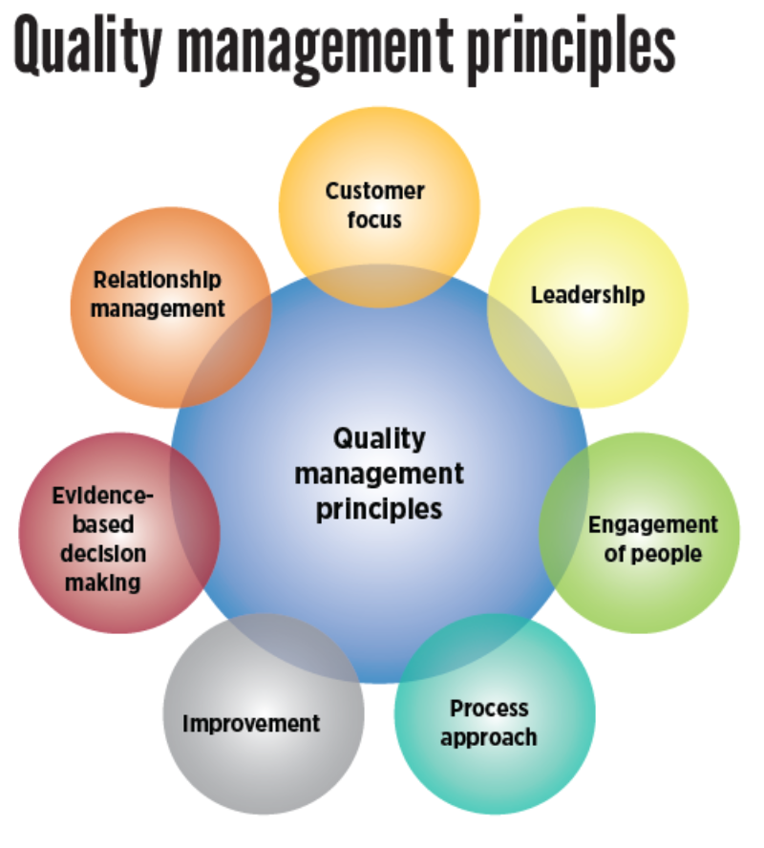
INTRODUCTION
A quality management system (QMS) is a formalized system that defines and documents an organization’s processes, procedures, and responsibilities for achieving quality policies, practices, and objectives. It helps an organization coordinate and direct its activities to meet customer and regulatory requirements, as well as continuously improve its effectiveness and efficiency.

Slide 5
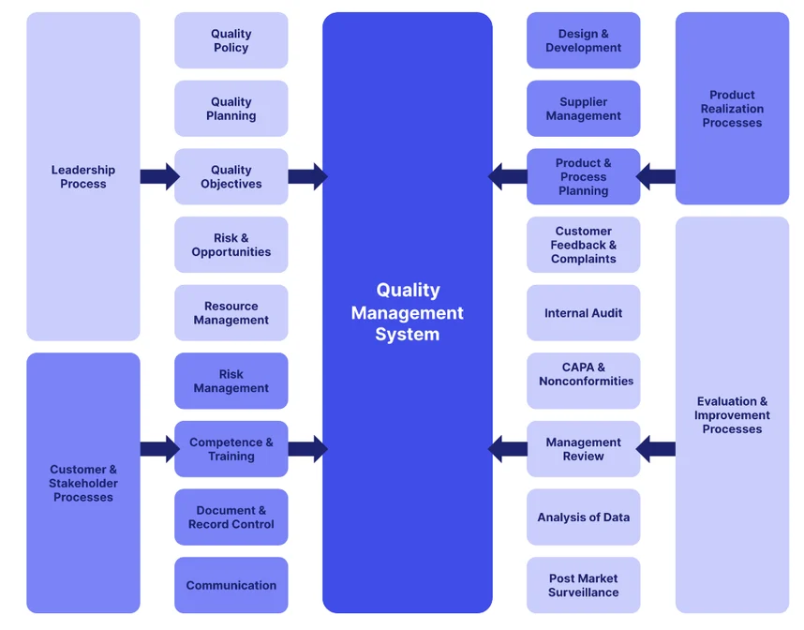
KEY FEATURES

Slide 6
MODULES OF QMS SYSTEM
Training Management
Complaint Management
Record Retention and Management
Risk Assessment
Change Control
Recall Procedure
Corrective Action & Preventive Action
Deviation & Incidence Reporting
Internal Quality Audit
Vendor management
Document Issuance & Accountability Record
Management Review Meeting Procedure
Reference (control) sample Management

Slide 7
MODULES OF QMS SYSTEM
Training Management:
Training Management in QMS Software that helps organizations plan, execute, track, and report on training and development activities. It ensures that employees are properly trained, qualified, and up-to-date on necessary processes, procedures, and compliance requirements. This is a critical component for maintaining consistent quality standards and regulatory compliance across an organization.
Training Management Forms:
Job Description
Training Matrix
Induction Training Plan
Training Questionnaire
Answer Key
Training Record
Training Calendar
Self-Declaration for Training Completion
Effectiveness Testing Record for Training Conducted
Employee Handover form
Workflow: All types of documents are issued by Quality Assurance department
Issue Generate Initiate Review/Approve

Slide 8
2. Complaint Management:
Complaint Management in Quality Management System (QMS) software refers to the process of capturing, tracking, and resolving customer or internal complaints related to product or service quality. It helps organizations systematically address and resolve issues while maintaining high customer satisfaction, ensuring compliance with quality standards, and identifying areas for continuous improvement.
Complaint Management Forms:
Complaint Investigation Report
Complaint Log
Complaint acknowledgement Record
Workflow: All types of documents are issued by Quality Assurance department
Issue Generate Initiate Review Client Approve

Slide 9
3. Record Retention and Management:
Record Retention and Management in Quality Management System (QMS) software is an essential process for ensuring that an organization maintains, organizes, and retrieves its critical records in compliance with regulatory standards, industry best practices, and internal quality policies. These records can include everything from training documents, audit reports, complaint logs, to product specifications and corrective actions. Proper record retention ensures that data is available for audits, inspections, and decision-making while minimizing the risks associated with lost or mishandled information.
Record Retention and Management Forms:
Retrieval Log
Return of Client Documents
Document/ Record Destruction Form
Archival/Retrieval Request Form
Archival Log
Archived Document Inspection Record
Workflow: All types of documents are issued by Quality Assurance department
Issue Generate Initiate Review/Approve

Slide 10
4. Risk Assessment:
Risk Assessment in a Quality Management System (QMS) refers to the systematic process of identifying, evaluating, and prioritizing potential risks that may impact an organization's ability to meet quality standards, regulatory requirements, or operational goals. The aim is to proactively manage risks to ensure product quality, safety, compliance, and continuous improvement. By incorporating risk assessments into the QMS, organizations can mitigate negative impacts, minimize defects, and improve overall performance.
Risk Assessment Forms:
Risk Assessment Form
Risk Numbering Log
Effectiveness Testing of Risk Assessment
Workflow: All types of documents are issued by Quality Assurance department
Issue Generate Initiate Review/Approve

Slide 11
5. Change Control :
Change Control in a Quality Management System (QMS) refers to the formal process of managing changes to processes, procedures, products, or systems in a controlled and systematic manner. The goal of change control is to ensure that all changes are evaluated for their impact, properly documented, and communicated, thereby maintaining product quality, regulatory compliance, and operational consistency.
Change Control Forms:
Change Control Form
Change Control Numbering Log
Workflow: All types of documents are issued by Quality Assurance department
Issue Generate Initiate Review Client Initiate Review Approve

Slide 12
6. Corrective Action & Preventive Action :
Corrective Action (CA) and Preventive Action (PA) are critical elements in a Quality Management System (QMS) that help organizations address non-conformities, improve processes, and ensure continuous quality improvement. These actions are designed to fix existing issues (Corrective Actions) and prevent future occurrences of similar problems (Preventive Actions), ultimately contributing to higher product quality, customer satisfaction, and regulatory compliance.
Corrective Action & Preventive Action Forms:
CAPA report
CAPA numbering log
Workflow: All types of documents are issued by Quality Assurance department
Issue Generate Initiate Review Client Initiate Review Approve

Slide 13
7. Recall Procedure :
Recall Procedure in a Quality Management System (QMS) refers to the systematic process that organizations follow when a product is found to be defective, unsafe, or non-compliant with quality standards, necessitating its removal from the market or customer use. A recall procedure is essential to mitigate risks to consumer safety, ensure compliance with regulatory requirements, and protect the company’s reputation. This process ensures that any defective or potentially harmful products are identified, tracked, and removed from circulation in a controlled and efficient manner.
Recall Procedure Forms:
Recall Notification Checklist
Clinical Supplies Recall Report
Recall Log
Mock Recall Report
Workflow: All types of documents are issued by Quality Assurance department
Issue Generate Initiate Review Approve

Slide 14
8. Deviation & Incidence Reporting:
A Deviation in a Quality Management System (QMS) refers to any occurrence where a product, process, or service fails to meet predefined standards, specifications, or procedures. Deviation can happen in any phase of the manufacturing or service delivery process, including design, development, production, testing, and distribution. Identifying, documenting, and resolving deviations promptly is crucial for maintaining product quality, ensuring customer safety, and complying with regulatory requirements.
An Incident Report in a Quality Management System (QMS) is a formal document that records any unplanned or unexpected event that may affect the quality, safety, or compliance of products, processes, or services. Incidents can include safety breaches, equipment failures, contamination, accidents, product defects, or any other unexpected events that disrupt the normal operation of a business and potentially lead to a deviation from quality standards or regulatory requirements.
Deviation & Incidence Reporting
Forms:
Deviation Report
Deviation Numbering Log
Incidence Report
Incidence Log
Workflow: All types of documents are issued by Quality Assurance department
Issue Generate Initiate Review Approve

Slide 15
9. Internal Quality Audit:
An Internal Quality Audit in a Quality Management System (QMS) is a structured, systematic process used to assess and evaluate an organization’s adherence to its established quality management processes, standards, and policies. The goal of an internal audit is to ensure that the QMS is functioning effectively, identifying areas for improvement, and ensuring compliance with internal and external requirements, including regulatory standards and industry best practices.
Internal audits are essential for maintaining continuous improvement and ensuring that an organization’s quality management system is robust, efficient, and compliant.
Internal Quality Audit Forms:
Internal Quality Audit Schedule
IQA Report
Internal Audit Schedule
IQA Response
List of IQA auditors
Internal Audit Observation Record
Internal Quality Audit Checklist- All departments
Internal audit certificate
Workflow: All types of documents are issued by Quality Assurance department
Issue Generate Initiate Review/Approve

Slide 16
10. Vendor management:
Vendor Management in a Quality Management System (QMS) refers to the process of selecting, evaluating, and overseeing suppliers or vendors to ensure that the goods and services they provide meet the required quality standards, regulatory requirements, and business needs. Effective vendor management is crucial in a QMS because the quality of raw materials, components, and outsourced services directly affects the quality of the final product or service.
Vendor Management Forms:
Checklist for Vendor Audit
Vendor Audit Report
Vendor Approval Form
Master Vendor List
Vendor Audit Calendar
Vendor Identification Form
Audit observation sheet
Audit Questionnaire for Third Party Depots
Third Party Depot Approval Certificate
Master Depot List
Requalification Schedule for Third Party Depots
Workflow: All types of documents are issued by Quality Assurance department
Issue Generate Initiate/Review Client Approve

Slide 17
11. Document Issuance & Accountability Record :
Document Issuance & Accountability Record in a QMS System refers to the process of controlling and managing the creation, distribution, access, and revision of critical documents within the Quality Management System (QMS). This process ensures that all individuals who need access to the documentation (e.g., quality procedures, policies, work instructions, forms, etc.) are accountable for its receipt, understanding, and proper use. Proper document control is essential for maintaining compliance with regulatory standards, ensuring process consistency, and maintaining the integrity of the QMS.
Document Issuance & Accountability Record Forms:
Document Issuance Request
Document Accountability Log
Workflow: All types of documents are issued by Quality Assurance department

Slide 18
12. Management Review Meeting Procedure :
Management Review Meeting Procedure in a Quality Management System (QMS) is a structured process that ensures top management regularly evaluates the performance and effectiveness of the QMS. It provides an opportunity for senior leadership to assess whether the QMS is achieving its objectives, identify areas for improvement, and ensure that it remains aligned with organizational goals, industry regulations, and customer requirements.
The Management Review meeting is typically required by quality standards such as ISO 9001 (Quality Management Systems) and serves as an essential part of continuous improvement.
Management Review Meeting Procedure Forms:
Minutes of the Meeting for Management Review Meeting
Quality Objective Plan
Quality Objective Report
Workflow: All types of documents are issued by Quality Assurance department
Issue Generate Initiate Review/Approve

Slide 19
13. Reference (control) sample Management:
Reference (Control) Sample Management in a Quality Management System (QMS) is a process of systematically managing samples of materials, components, or products that are used to ensure the consistent quality and integrity of production, testing, and product performance. Reference or control samples are preserved as a baseline for comparison and verification throughout the lifecycle of the product or material, and they are essential for performing quality checks, conducting audits, and meeting regulatory compliance.
In regulated industries such as pharmaceuticals, medical devices, food manufacturing, and chemicals, managing reference samples is critical for maintaining product quality, ensuring traceability, and meeting industry standards (e.g., ISO, GMP, FDA). The Reference Sample Management process ensures that these samples are properly stored, documented, and accessible for periodic testing, future comparison, and validation purposes.
Reference (control) sample Management Forms:
Reference (control) sample Label
Reference (control) sample logbook
Periodic review of Reference (control) sample
Workflow: All types of documents are issued by Quality Assurance department
Issue Generate Initiate Review/Approve

Slide 20
Implementation Process of QMS Software
Project Planning
Implementing a Quality Management System (QMS) software involves a structured process to ensure the software is integrated effectively into your organization.
Planning and Assessment
Selection of Software
Customization and Configuration
Data Migration
Training and Change Management
Testing
Go Live
Post-Implementation Support and Improvement
Regular Audits and Updates

Slide 21
User Training
Training for the implementation of a Quality Management System (QMS) software is crucial for ensuring that all users understand how to effectively utilize the system and integrate it into their daily workflows.
Pre-Training Preparation
Training Sessions Overview
Role-Specific Training
Hands-On Practice
Q&A and Troubleshooting
Post-Training Support
Feedback and Continuous Improvement
Evaluation of Training Effectiveness
Supportive Environment

Slide 22
BENEFITS OF IMPLEMENTING QMS
Risk Management
Document Control
Risk Identification: Risk identification involves systematically detecting potential risks that could impact the quality management process, allowing organizations to address them proactively.
Risk Mitigation Strategies: Risk mitigation strategies provide structured approaches to minimize the impacts of identified risks, ensuring quality standards are maintained throughout the operational processes.
Compliance Management: Compliance management ensures that all processes adhere to regulatory requirements and standards, minimizing legal risks and enhancing overall quality assurance.
Centralized Repository: A centralized repository ensures all quality management documents are stored in a single, secure location, making access and retrieval efficient for authorized personnel.
Version Control: Version control allows tracking of changes and updates to documents over time, ensuring users always access the latest, approved versions and maintain a history of document revisions.

Slide 23
Regulatory Compliance and QMS Software
Regulatory Compliance in Quality Management System (QMS) Software helps organizations meet industry-specific regulatory requirements, such as those from governmental agencies and standards organizations (e.g., ISO, FDA, GMP). By automating compliance tasks and ensuring traceability, QMS software streamlines processes to track regulatory requirements and maintain necessary documentation.
Key features include:
Centralized Document Control: Organizing and tracking regulatory documents.
Audit Management: Supporting internal and external audits, ensuring readiness for regulatory inspections.
Compliance with Industry Standards: Ensuring adherence to ISO, GMP and FDA standards.
Change Control Management: Documenting and assessing changes for regulatory impact.
Risk Management: Identifying and mitigating risks related to non-compliance.
Training Management: Managing compliance-related training and certifications.
Supplier Compliance: Auditing and ensuring vendor compliance with regulatory standards.
Product Lifecycle Management: Maintaining traceability from raw materials to finished products.
Non-Conformance and CAPA: Managing corrective and preventive actions to address non-conformances.
Electronic Records: Ensuring compliance with FDA 21 CFR Part 11 for electronic records and signatures.

Slide 24
Notifications in QMS software
Email Notifications:
System Notifications:
Our QMS software ensures you never miss an important action or submission by providing real-time email notifications for every critical task. Whether it's document approvals, audit schedules, training updates, or compliance deadlines, our software keeps you informed and on track, helping you maintain quality standards and regulatory compliance seamlessly.
Automated System-Generated Notifications for Every Action and Submission
Our QMS software ensures seamless communication and accountability by providing system-generated notifications for every action and submission. This feature helps keep your team informed, ensures timely completion of tasks, and supports compliance with industry standards.

Slide 25
Validation Documents of QMS software
Validation documents in a Quality Management System (QMS) are essential for ensuring that processes, systems, and products meet predefined standards and regulatory requirements. In industries such as pharmaceuticals, biotechnology, medical devices, and manufacturing, validation is a critical component of maintaining quality, safety, and compliance.
The User Requirements Specification (URS) for Quality Management System (QMS) software is a critical document that defines the essential functionalities, features, and performance criteria that the software must meet in order to effectively support an organization’s quality management processes. The URS helps align the expectations of the stakeholders and serves as a foundation for software selection, development, and validation.
Qualification Documents:
Installation Qualification (IQ):
Purpose: IQ verifies that the QMS software has been properly installed according to the specifications and that the system components are correctly configured.
2. Operational Qualification (OQ):
Purpose: OQ confirms that the QMS software operates as intended in the actual operational environment and that all core functionalities are working correctly.
3. Performance Qualification (PQ)
Purpose: PQ confirms that the QMS software performs consistently under real-world conditions and that it meets the organization’s expectations for operational use over time.

Slide 26

Conclusion
Conclusion: Quality Management System (QMS) software plays a pivotal role in modern organizations by streamlining and automating key quality management processes. Whether it's ensuring regulatory compliance, managing documentation, conducting audits, or implementing CAPA (Corrective and Preventive Action) workflows, QMS software helps organizations maintain consistent quality, minimize risks, and achieve continuous improvement.
With the increasing complexity of regulatory requirements and the demand for operational efficiency, QMS software provides businesses with a comprehensive platform to centralize their quality management efforts, ensure adherence to industry standards, and enhance accountability. By integrating various quality-related functions into a single system, QMS software enables real-time monitoring, effective decision-making, and a proactive approach to quality management.
Key Takeaways:
Centralized Quality Control 8. Faster Time to Market
Regulatory Compliance 9. Scalability and Customization
Improved Efficiency 10. Cost Savings
Enhanced Collaboration and Communication
Data Integrity and Traceability
Risk Management
Continuous Improvement
Improve Quality
Reduce Errors

Slide 27




THANK YOU
Contact Us
Mail
services@soluxction.com
Website
www.soluxction.com
“Experience Soluxction - Where Precision, Reliability, and Innovation Drive towards Success”

